Slide 1

Fraud Detection in Credit Transactions
Leveraging Machine Learning for Enhanced Financial Safety
Class: DS 862
12/13/2024
Presented by: Kiran Ranganalli
Shaik Faiz Ahmed

Slide 2

AGENDA
INTRODUCTION
Problem Definition
Workflow Overview
Exploratory Data Analysis
Data Preprocessing
Model Development
Insights and Recommendations
Conclusion
Questions and Discussion

Slide 3

Introduction
Background:
Credit card fraud is a critical issue affecting financial institutions and consumers globally.
With the rise of online transactions, fraud detection systems need to be more robust and efficient.
Project Goal:
Utilize machine learning techniques to detect fraudulent transactions accurately and in real-time.
Dataset Overview:
Source: Kaggle—Credit Card Fraud Detection Dataset 2023.
Contains anonymized transaction data with labeled instances of fraud and non-fraud.
Key Features: Time, Amount, PCA-transformed variables.

Slide 4

Problem Definition
Objective:
Build a machine learning model to accurately detect fraudulent credit card transactions.
Challenges:
High class imbalance between fraud and non-fraud cases.
Need for real-time and accurate fraud detection to minimize financial loss.
Success Metrics:
High Recall: Minimize missed fraud cases.
Precision and F1-Score: Balance detection

Slide 5

Workflow Overview
Exploratory Data Analysis (EDA): Understand data patterns and distributions.
Data Preprocessing: Handle missing values, scale features, and balance classes.
Feature Engineering: Create new features and reduce dimensionality.
Model Development: Train and evaluate machine learning models.
Insights and Recommendations: Identify key fraud patterns.

Slide 6
Exploratory Data Analysis (EDA)
Dataset Overview:
Total Records: 284,807
Features: 31 (30 PCA-transformed features, Time, Amount, Class)
Target (Class): Fraudulent = 0.17%, Non-Fraudulent = 99.83%
Key Findings:
Class Imbalance:
Fraud cases are significantly fewer than non-fraud cases.
Feature Distributions:
Amount: Highly skewed with smaller transaction amounts dominating.
Time: Represents elapsed time since the first transaction. No distinct pattern observed.
Correlation Analysis:
Features are PCA-transformed, showing low multicollinearity.
No significant correlation with Class.

Slide 7
Exploratory Data Analysis
Visualizations

Slide 8
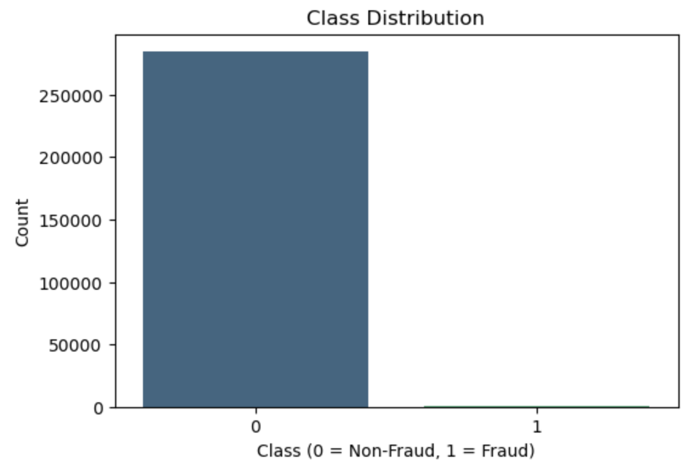
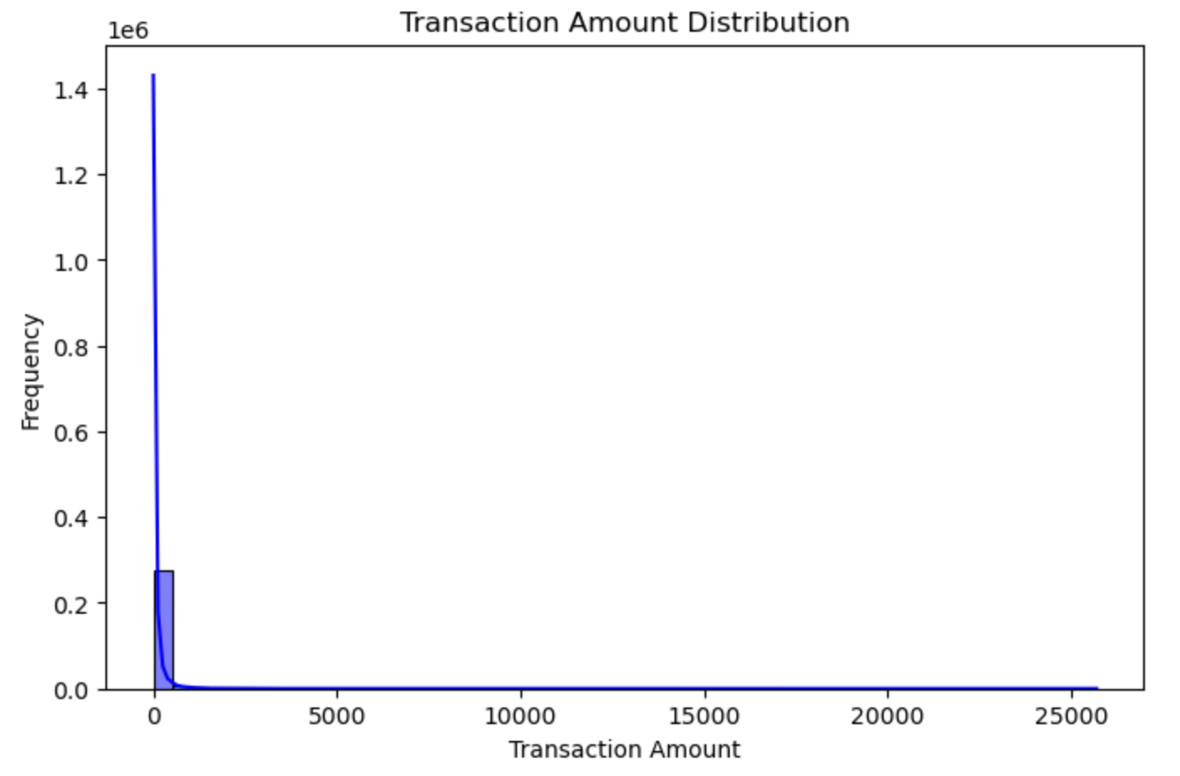
Visualization
Fraud to Non-Fraud Ratio: 0.0017304
Only a small percentage of transactions are fraudulent
The transaction amount distribution is highly skewed, with most transactions concentrated at lower values, while a few extend to significantly higher amounts.

Slide 9
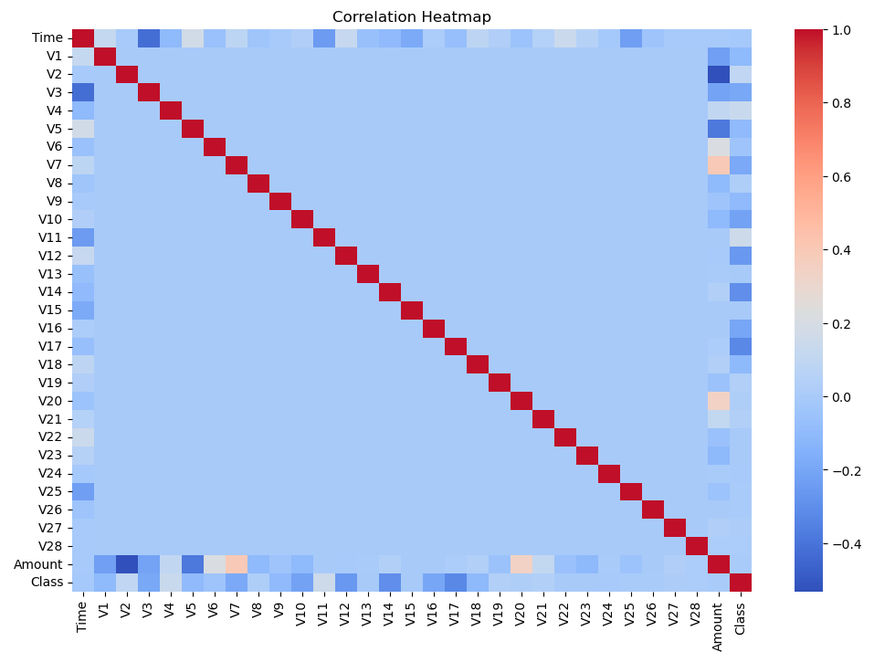
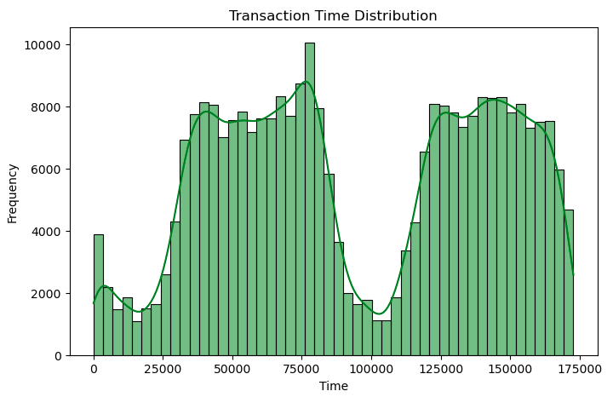
Visualization
Correlation: Features show low multicollinearity
Feature Distributions:

Slide 10
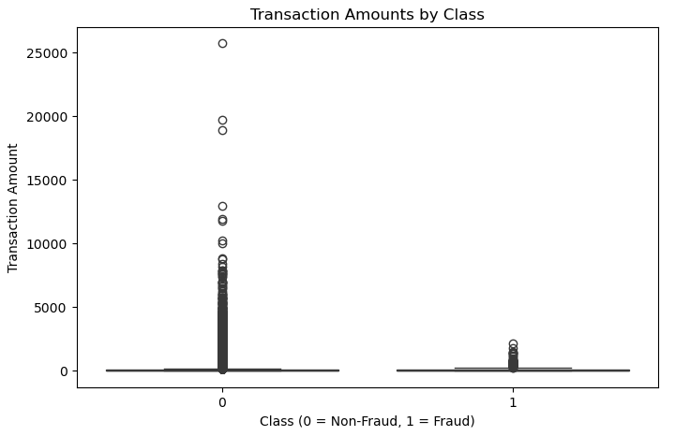
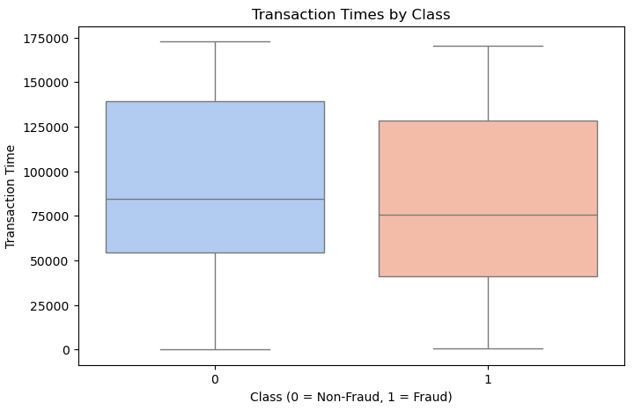
Visualization

Slide 11
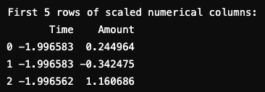
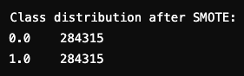
Data Preprocessing
Handled Missing Values:
Verified no missing values in the dataset.
Scaled Numerical Features:
Time and Amount scaled using StandardScaler for consistent feature contribution.
Addressed Class Imbalance:
Applied SMOTE (Synthetic Minority Over-sampling Technique) to balance the dataset.
Fraud and Non-Fraud classes now have equal representation.
Outcome:
Created a clean, balanced, and normalized dataset ready for feature engineering and modeling.
Missing values after imputation: 0

Slide 12
Feature Engineering
Purpose:
Enhance model performance by creating meaningful features.
Reduce dimensionality while retaining maximum variance.
Steps Taken:
Derived Features:
Transaction Velocity: Calculated the number of transactions in a rolling time window.
Rolling Averages: Computed average transaction amounts over recent transactions.
Dimensionality Reduction:
Applied PCA (Principal Component Analysis):
Retained 95% variance while reducing the feature space.
Reduced features to the most relevant PCA components, improving computational efficiency
Outcome:
Dataset enriched with relevant features.
Dimensionality reduced for faster and more efficient modeling.

Slide 13

Model Development
Models Trained:​
Logistic Regression:​
Baseline model to establish reference performance.​
Random Forest:​
An ensemble model that leverages decision trees for better handling of non-linear relationships.​
Handles imbalanced data effectively with class weights.​
XGBoost:​
A gradient boosting algorithm known for high accuracy and performance on imbalanced datasets.​
Optimized for faster training and better handling of overfitting.​
ROC-AUC: Evaluates overall model performance.​
​

Slide 14
Model Evaluation
Model | Logistic Regression | Random Forest | XG Boost
Accuracy | 51% | 92% | 92%
Precision | 0.50 | 0.97 | 0.97
F1-Recall | 1.00 | 0.86 | 0.87
F1-Score | 0.67 | 0.91 | 0.92
Observation | Captured all fraud cases but had a high false positive rate | Balanced performance with fewer false positives compared to Logistic Regression | Outperformed Random Forest slightly in terms of F1-Score and ROC-AUC
Conclusion:
Best Model: XGBoost with the highest ROC-AUC score of 0.9628 and balanced precision-recall for fraud detection.

Slide 15
Tuning of XGBoost and Random Forest Models
XGBoost Model
Approach:
Used RandomizedSearchCV with parameters like n_estimators, max_depth, learning_rate, and scale_pos_weight.
Conducted 10 iterations over a reduced parameter space with 2-fold cross-validation.
Outcome:
Best Parameters: {'n_estimators': 200, 'max_depth': 5, 'learning_rate': 0.1, 'scale_pos_weight': 25}.
Achieved a ROC-AUC score of 0.9628 with high recall and precision.
Random Forest Model
Approach:
Used RandomizedSearchCV to explore parameters like n_estimators, max_depth, min_samples_split, and min_samples_leaf.
Conducted 30 iterations with 3-fold cross-validation.
Outcome:
Best Parameters: {'n_estimators': 300, 'max_depth': 20, 'min_samples_split': 2, 'min_samples_leaf': 1}.
Achieved a ROC-AUC score of 0.9544 with balanced precision and recall.
Key Insights
XGBoost is ideal for achieving high accuracy and recall, especially in complex datasets.
Random Forest is simpler, faster, and provides comparable results for moderately complex patterns.

Slide 16
Insights and Recommendations
Key Insights
XGBoost achieved a ROC-AUC Score of 0.9628, excelling in recall for fraud detection.
Random Forest achieved a ROC-AUC Score of 0.9544, offering balanced precision and recall with faster training.
Recommendations:
Deploy XGBoost for accurate fraud detection in production systems.
Use Random Forest for faster, moderately accurate results.
Regularly retrain models to adapt to evolving fraud patterns.

Slide 17
Conclusion
Summary
Developed a robust fraud detection pipeline.
Achieved high performance metrics for both XGBoost and Random Forest.
Identified actionable insights, such as transaction amount, as key fraud indicators.
Next Steps
Deploy the best-performing model (e.g., XGBoost) as an API or integrated system.
Explore ensemble methods to further optimize performance.
Regularly retrain models to adapt to evolving fraud patterns.

Slide 18

THANK YOU
Questions?

